Slide 1
1 Introduction

Slide 2
Complex system
Internet
  On-line social network media
    Facebook
    Twitter
  World Wide Web
Human Institutions
  Governments
  Economies

Slide 3
Complex system
Infrastructures
  Transportation networks
  Electricity networks
Humans
  various, complex, inter-connected systems
  inter-acting genes
  communicating neurons
Entire eco-systems
Biological food webs

Slide 4
1.1 Why Networks?
Ultimately, the study of systems such as those just described is accompanied by measurement and, accordingly, the need for statistical analysis.

Slide 5
Networks and Graphs
Frequently ‘network’ is used inter-changeably with the term ‘graph’ since, for mathematical purposes, networks are most commonly represented in a formal manner using graphs of various kinds.
Convention: we will use the term ‘network’ in its most general sense above, and—at the risk of the impression of a slight redundancy—we will sometimes for emphasis refer to a graph representing such a network as a ‘network graph.’

Slide 6
Computational biology
  studying systems of interacting genes, proteins, chemical compounds, or organisms,
Engineering
  establishing how best to design and deploy a network of sensing devices
Finance
  studying the interplay among, say, the world’s banks as part of the global economy)
Marketing
  assessing the extent to which product adoption can be induced as a type of ‘contagion’),

Slide 7
Neuroscience
  exploring patterns of voltage dynamics in the brain associated with epileptic seizures
Political science
  studying how voting preferences in a group evolve in the face of various internal and external forces
Public health
  studying the spread of infectious disease in a population, and how best to control that spread

Slide 8
Why Network Analysis
A network-based perspective recently has been found to be useful in the study of complex systems across a diverse range of application areas.
The focus of the course is on how to use tools (particularly, in R) to do statistical analysis of network data.
More specifically, the aim is to present tools for performing what are arguably a core set of analyses of measurements that are either of or from a system conceptualized as a network.

Slide 9
1.2 Types of Network Analysis
Each area of specialization has its own unique questions and problems under study.
Nevertheless, from a statistical perspective, there is a methodological foundation that has emerged, composed of tasks and tools that are each common to some non-trivial subset of research areas involved with network science.

Slide 10
1.2 Types of Network Analysis
Descriptives
  Visualization
  Characterization
Modeling
  Mathl and Statl Models for Network Graphs
Inference
  Network topology
  Processes on networks

Slide 11
1.2.1 Visualizing and Characterizing Networks
The visualization and numerical characterization of a network is usually the first steps in network analysis.
In practice, descriptive analyses constitute the majority of network analyses published.

Slide 12
Techniques for displaying network graphs are the focus of the field of graph drawing or graph visualization.
Such techniques typically seek to incorporate a combination of elements from mathematics, human aesthetics, and algorithms.

Slide 13
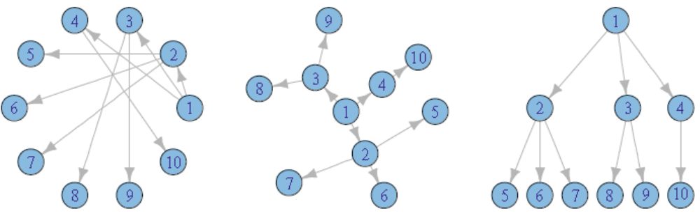
Layout
Three layouts of the same graph: circular (left), radial (center), and layered (right)

Slide 14
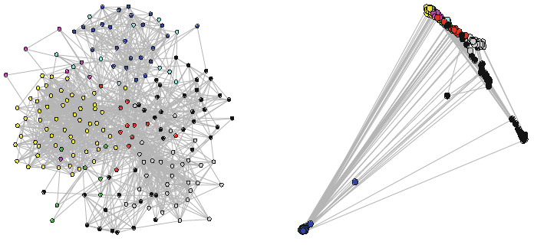
Layouts using algorithms
L: Kamada-Kawai algorithm
R: DrL algorithm

Slide 15
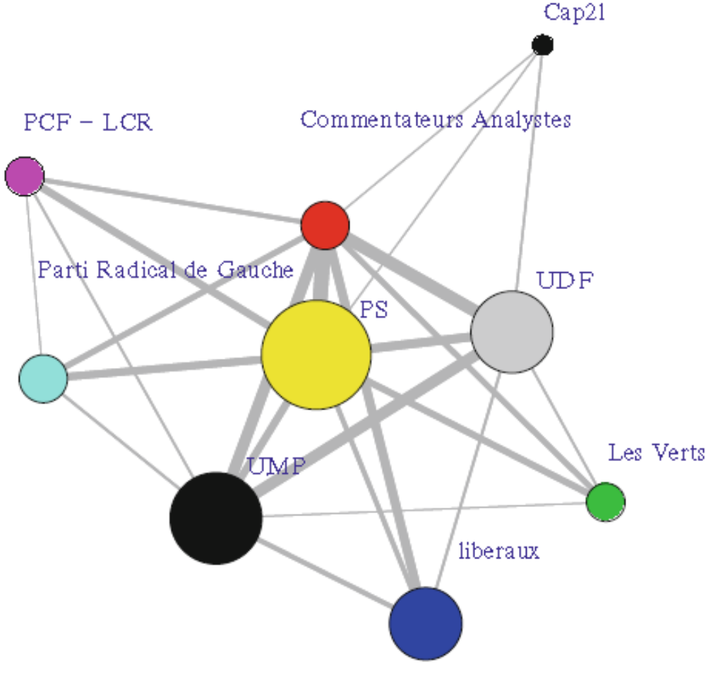
Decorating Graph Layouts

Slide 16
Decorating Graph Layouts
As a representation of a complex system, a graph alone (i.e., as merely a collection of vertices and edges) is often insufficient.
Rather, there may be additional information important to the application at hand, in the form of variables that can be indexed by the vertices (e.g., gender of members of a social network) or the edges (e.g., average time required to traverse a link in a transportation network)

Slide 17
Decorating Graph Layouts
At a coarser level of granularity, it may be convenient to associate vertices or edges with groups (e.g., all proteins in a protein–protein interaction network that are involved with a certain type of signaling event in a cell).
The notion of decorating a network graph is just equipping vertices and edges with several variables of interest

Slide 18
Descriptive Analysis of Network Graph
Characteristics
Unlike the types of summaries encountered typically like simple measures of center tendency (e.g., mean, median, etc.) and dispersion (e.g., std dev, range, etc.) for a set of real numbers, summary measures for networks necessarily seek to capture characteristics of a graph.

Slide 19
Descriptive Analysis of Network Graph
Characteristics
There are a host of network summaries available, with more being defined regularly.
These range from characterization of properties associated with individual vertices or edges to properties of subgraphs to properties of the graph as a whole.
  characterization of individual vertices and edges, and
  characterization of network cohesion (i.e., involving more than just individual vertices and edges).

Slide 20
Vertex and Edge Characteristics
Degree
  Degree Distributions
  Degree Correlation
Centrality
  Closeness centrality
  Betweenness centrality
  Eigenvector centrality

Slide 21
Characterizing Network Cohesion
Local Density
Connectivity
Assortativity and Mixing
Transitivity

Slide 22
Descriptive Analysis of Network Graph
Characteristics
The trick to employing network characterizations in a useful fashion generally is in matching the question(s) of interest in an underlying complex system with an appropriate summary measure(s) of the corresponding network.

Slide 23
1.2.2 Network Modeling and Inference
We can conceive of the network as having resulted from some underlying processes associated with the complex system of interest to us and ask what are the essential aspects of these processes.
In addition, the actual manner in which the network was obtained, i.e., the corresponding measurement and construction process, may well be important to take into consideration.
Such concerns provide the impetus for network modeling and associated tools of statistical inference.

Slide 24
1.2.2 Network Modeling and Inference
Broadly speaking, there are two classes of network models:
  Mathematical
    models specified through (typically) simple probabilistic rules for generating a network, where often the rules are defined in an attempt to capture a particular mechanism or principle and
  Statistical
    models with the intention that they be fit to observed that the fit be effected and assessed using formal principles of statistical inference

Slide 25
1.2.3 Network Processes
Stochastic processes indexed by the vertices in the network
A variety of questions regarding such processes can be interpreted as problems of prediction of either static or dynamic network processes.

Slide 26
1.2.3 Network Processes
Example 1
In on-line social networks like Facebook, users can choose privacy settings of various levels of severity.
It can be of interest (e.g., for marketing purposes) to predict user attributes (e.g., perhaps indicative of consumer preferences) based on that of ‘friends’.

Slide 27
1.2.3 Network Processes
Example 2
Proteins that work together to effect certain functions often have a higher affinity for physically binding to each other.
The clusters of highly connected proteins in protein–protein interaction networks can be exploited to make computational predictions of protein function, by propagating information on proteins of known function to their neighbors of unknown function in the graph.

Slide 28
1.2.3 Network Processes
Additionally
Statistical methods for analyzing network flows
  Referring to the movement of something—materials, people, or commodities, for example—from origin to destination, flows are a special type of dynamic process fundamental to transportation networks (e.g., airlines moving people) and communication networks (e.g., the Internet moving packets of information)
Dynamic network analysis
  The network, the process(es) on the network, or both, are expected to be evolving in time

Slide 29
Centrality

Slide 30
the idea of centrality is one of the key constructs within network graph analysis where we make an attempt to understand the relative influence of individual nodes within the network.

Slide 31
Degree centrality
Degree centrality measures examine the number (or proportion) of other nodes linked to a specific node, either through inbound, outbound, or undirected connections.
This type of node might act as a sort of hub for information flow—it might not be the source of direct information, but plays a critical role in dispersing this information to others.

Slide 32
Degree Centrality
A
F
In this case, D has direct connections to five of the six remaining nodes, while no other node has more than three such edges, making D a hub within the network.
Based on this structure, information is likely to flow though D, particularly as nodes communicate across the network (say from B to G).
D
B
G
E
C

Slide 33
Closeness centrality
a measure of the proximity of a selected node to all other nodes within the graph.
A node with strong closeness centrality would typically have very short paths to all other nodes within the network.
Note that the result will be a lower average number, as we are talking about how many steps it takes to reach all other nodes.

Slide 34
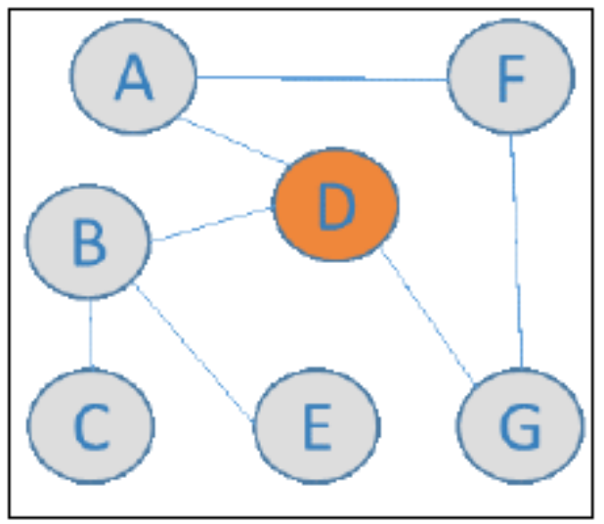
Closeness centrality
Note that Node D, despite having direct connections to just three of the six remaining nodes, has a maximum distance of two to reach any other point in the graph, while all other nodes have paths that might require three or even four steps.
Generally speaking, we would expect this type of node to lie at or near the physical center of a graph, although this is not always the case.

Slide 35
Betweenness centrality
In this case, we will find nodes that are highly influential in connecting otherwise remote regions of a graph
  even though these nodes might have low influence as measured by other centrality measures
These nodes form a bridge between parts of the graph and thus play a key role in reducing path distances when traversing the graph.

Slide 36
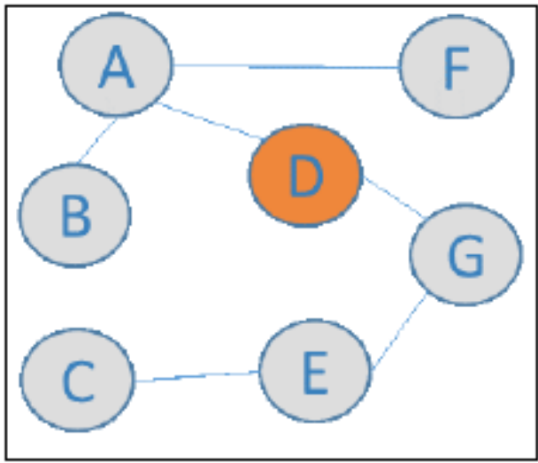
Betweenness centrality
In this case, D has just two first degree connections yet it plays a pivotal role in the network structure by being the bridge between the BAF and CEG clusters, which otherwise would be unable to connect.

Slide 37
Eigenvector centrality
the influence of a particular node is defined by the connectedness of its closest neighbors
This can be thought of as the who you know type of centrality, wherein an individual node might not be thought of as important on its own, but its relationship to other highly connected nodes indicates a high level of influence.

Slide 38
Eigenvector centrality
A
F
In this instance, D has only two first degree connections, but is surrounded by a host of very well connected nodes.
Node D would thus score highly on the eigenvector centrality measure due to the relative importance of its first and second degree neighbors.
D
B
G
E
C

Slide 39
Next Topic: Functional Data

